Slide 1
Create a Sample Dynamic Web Application in Eclipse IDE and
deploy it on IBM Sterling Integrator.
Arpit Jain

Slide 2
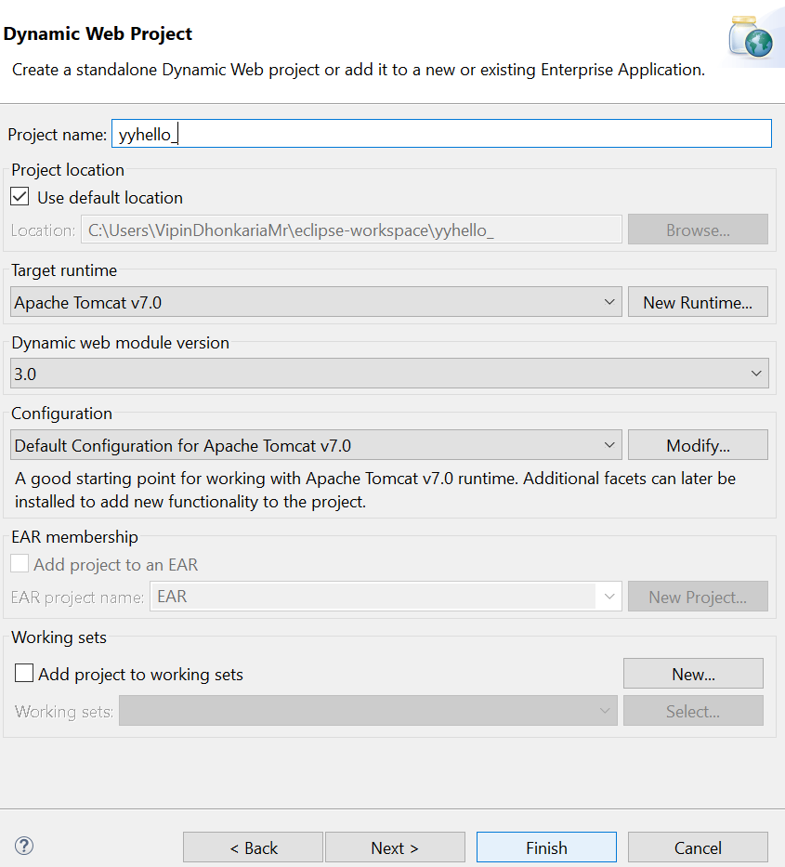
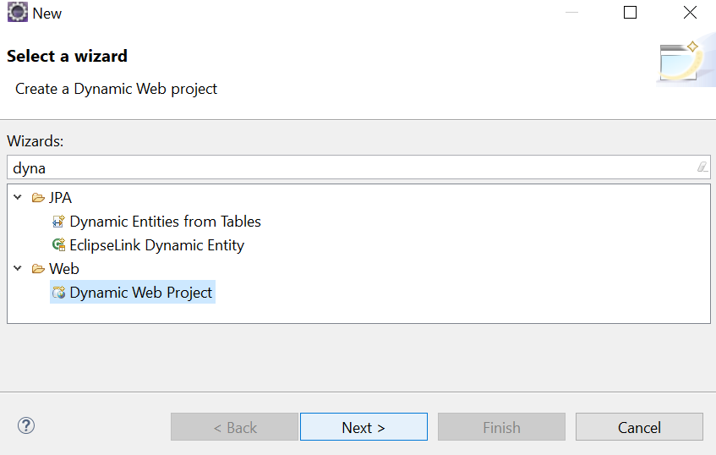
Step 1 : Create a new JSP Dynamic Web Application in Eclipse IDE

Slide 3
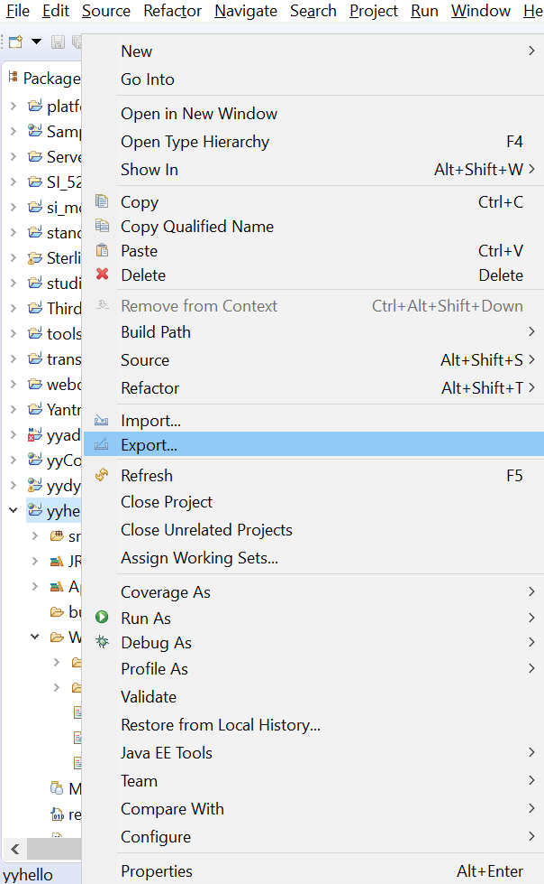
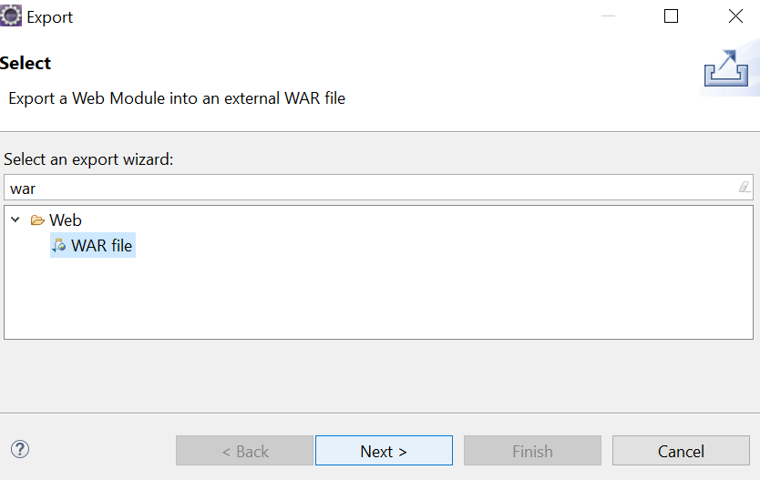
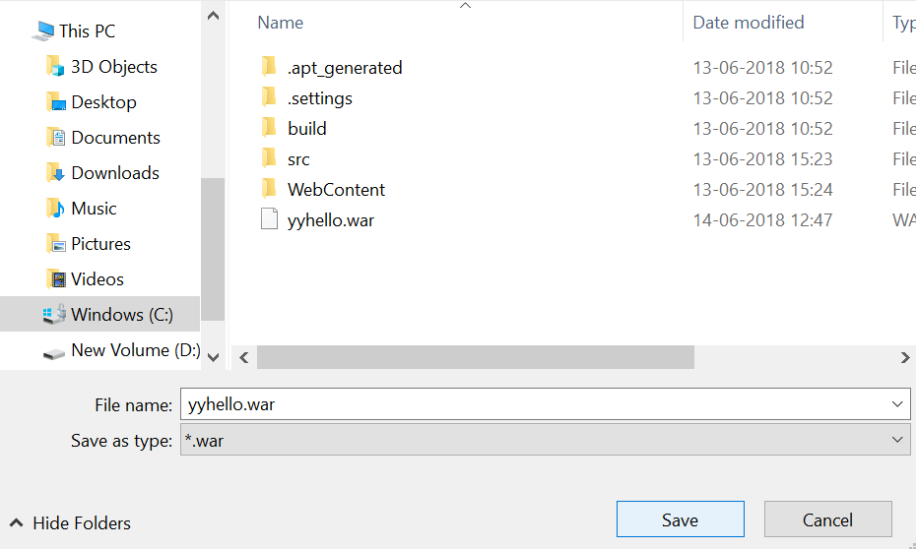
Step 2 : Code the application and then Export it as an WAR file

Slide 4
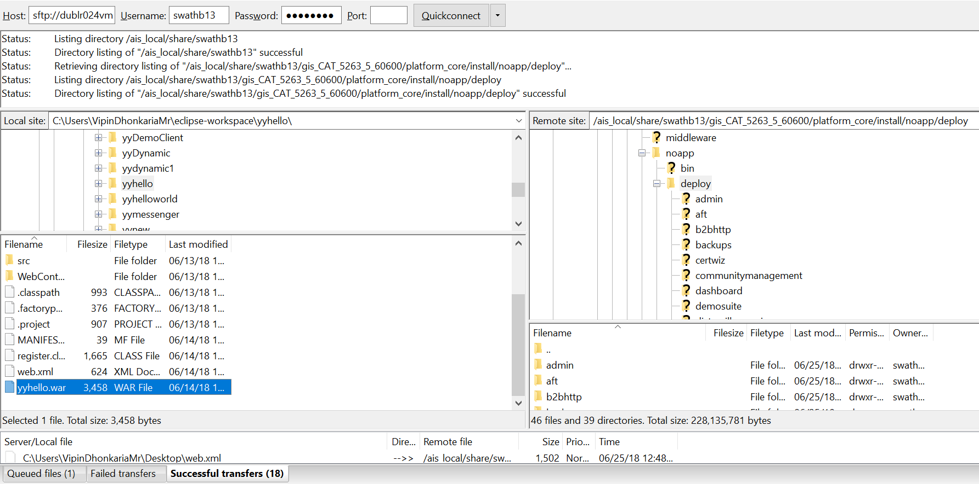
Step 3 : Connect to the B2Bi-SI server using Filezilla.
Step 4: Now, copy the WAR package to the server.

Slide 5
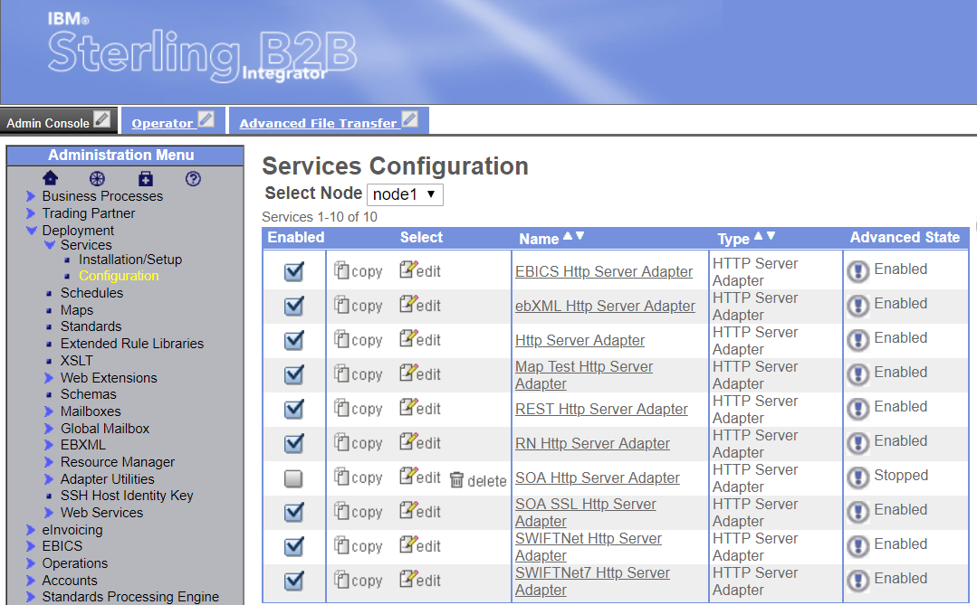
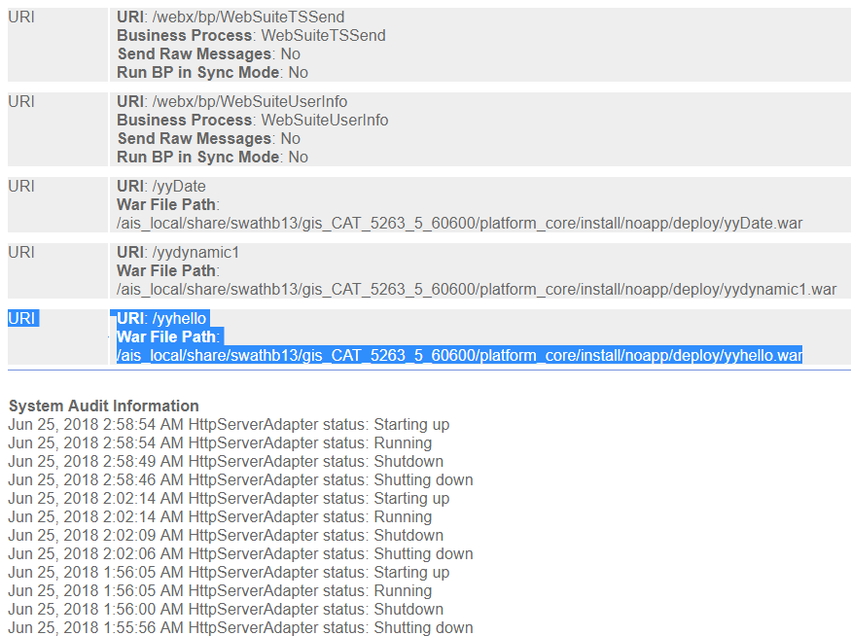
Step 5 : Edit the Http Server Adapter service of B2Bi-SI.
Step 6: Add an endpoint to the WAR file.

Slide 6
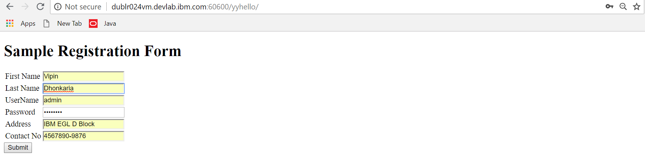
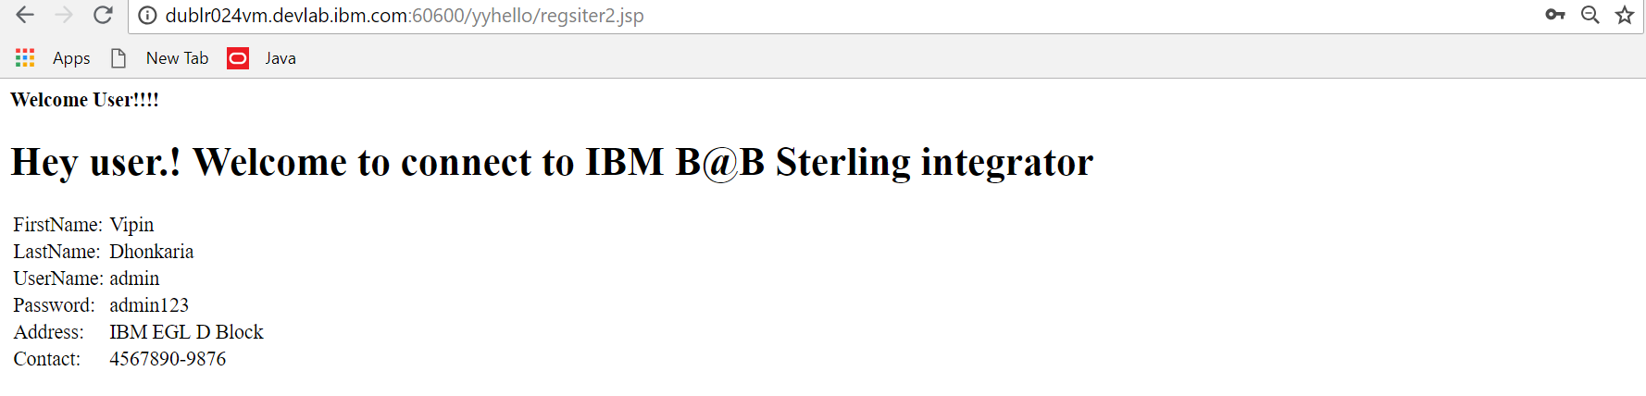
Step 7 : Wait for 10-15 Minutes so that the application is deployed.
Step 8: Go to the endpoint URI and check if the application is running.
Request Form
Response

Slide 7
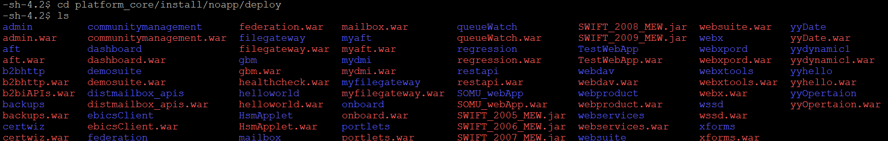
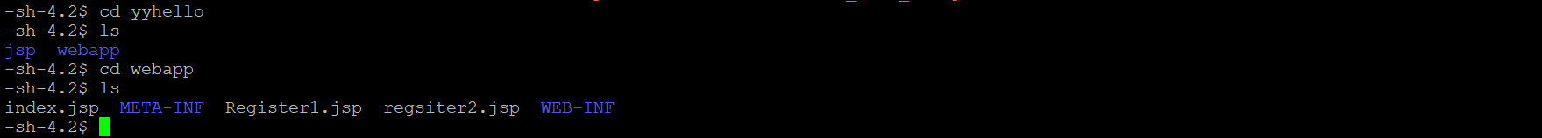
Step 9 : Check the deployed application files on the server.
Webapp files

